Slide 1
A Wireless Home Automation System
Team 5
Peter Li
Wenxuan Qiu
Jing Bo Yang

Slide 2
Project Overview

Slide 3
Project Objectives
Lists of user commands & modules
Mechanical door demo
Controller board change: DCT module -> Logarithm module
Hub board changes: Custom modules for servo and relay switch control
Foreign language command support
Commands | PMODs in use
Open / Close door | Servos
Light On/Off | Relay switch
Enter | Servos, relay switch, distance sensor

Slide 4
Controller Board Block Diagram
Interrupt Controller
DDR3
Microblaze
AXI Interconnect
DMA0
(AXI Stream)
DMA1
(AXI Stream)
DMA2
(AXI Stream)
AXI Lite GPIO
Digilent BT IP
Digilent Audio IP
Xilinx FFT IP
Xilinx Logarithm IP
Buttons
Bluetooth
Microphone
Speaker

Slide 5
Peter’s Role: Hardware Setup on Controller Board
Hardware change: DCT module -> Logarithm module
Challenges:
Bluetooth connection issues -> turn on Bluetooth modules at the same time
Inconsistent / imprecise results from Xilinx FFT IP -> use full precision setting
Inconsistent / imprecise results from Xilinx Log LP -> use max performance settings
Large amount of noise in audio recording -> set consistent sampling rates in codec
Digilent / Xilinx IPs with custom-coded APIs
Lessons learned to ensure success:
Each hardware recompile takes 20+ min
Constantly backing up functional versions
Test each interface individually before system integration
Finalize hardware early to give more time for Jing Bo’s software implementation

Slide 6
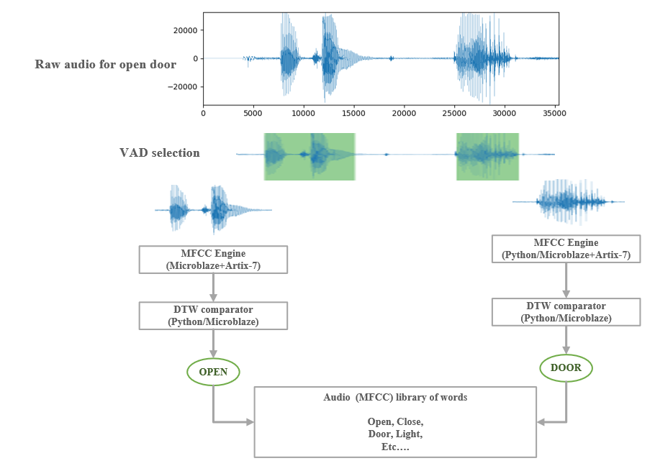
Voice Recognition Algorithm

Slide 7
Voice Recognition Algorithm
VAD, FFT, then MFCC computation with Dynamic Time Wrap comparison
Innovation: dynamic time wrap with length penalty
Problems
Audio samples must be collected from the same source (ADC quality)
Alignment of audio snippets
Computation efficiency
Lessons learned:
Python needs to be carefully written to enable simply transferring to C
Evaluation of processor computation capability before selecting algorithm

Slide 8
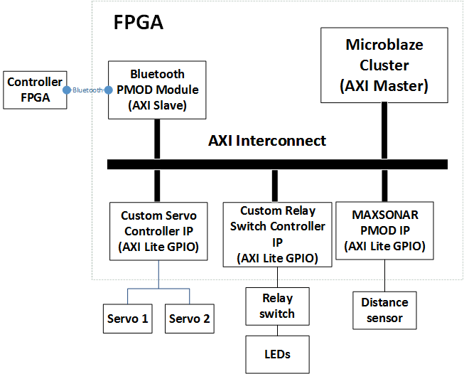
Hub Board Block Diagram

Slide 9
Hub FPGA Related Challenges
Controlling PMODs
Hardware IPs
Custom: Servo Controller, Relay Switch
Digilent: MAXSONAR (ultrasonic sensor)
Software control
Template from sample projects
Write individual features into C functions
Wooden door construction
Prototype and revise as issues arise and alternatives are found
Select the right material, tools, adhesives, and fasteners

Slide 10
Thank you! Q&A Time

Slide 11
Design Methodology
Modular design
Breakdown the system into components that can be designed individually
Integrate subsystems early and communicate frequently between team members
Git-based version control
Maintain latest versions of working code
Update weekly team meeting agenda and status
Prototyping
Build Python / Verilog application for quick prototyping of required functions
Prototype mechanical parts and revise design
Testing
Have test plans for individual subsystems
Individual IP component test bench and testing tools

Slide 12
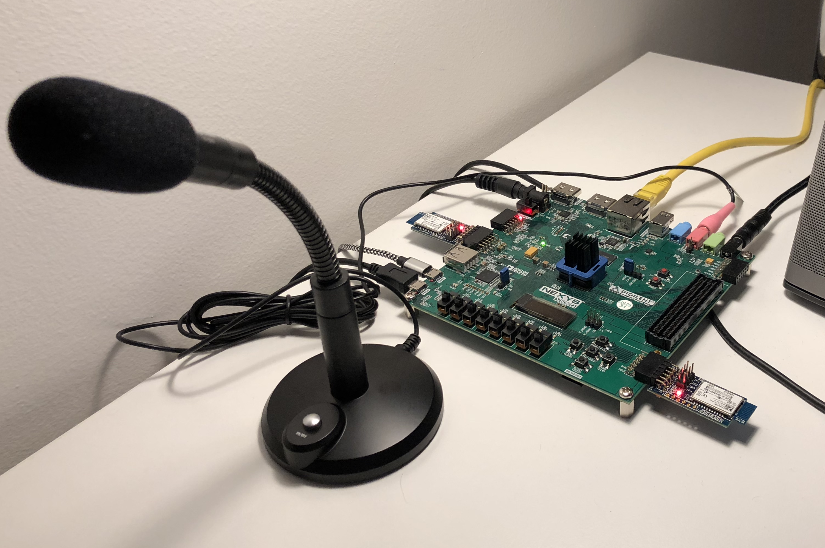
Bluetooth PMOD Testing
Initial testing: 2 PMOD on one FPGA
Final testing: 1 PMOD on each FPGA

Slide 13
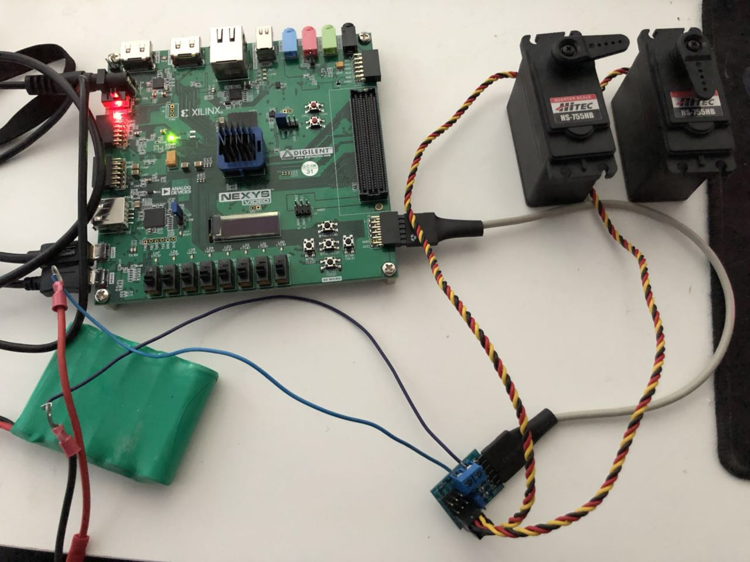
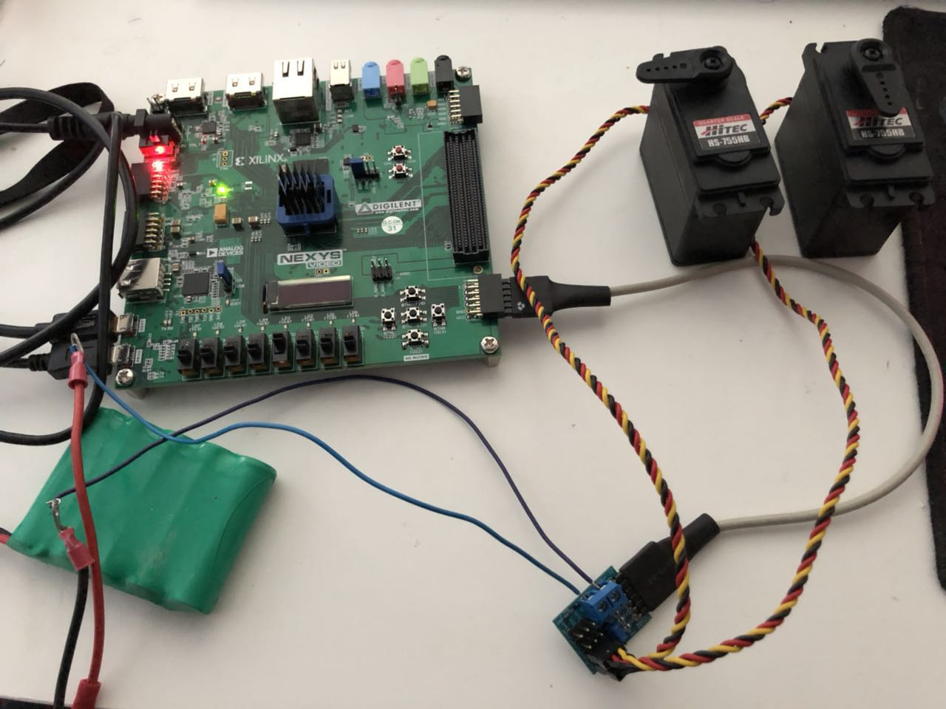
Servo Controller PMOD Testing
Servo angle controlled by switches

Slide 14
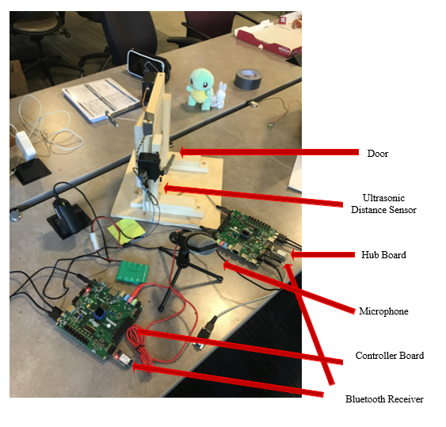

Slide 15
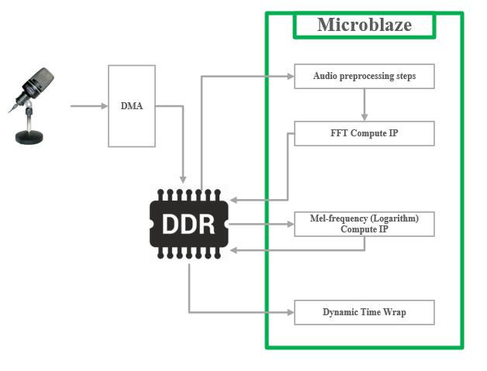
Data Flow for Voice Recognition

Slide 16
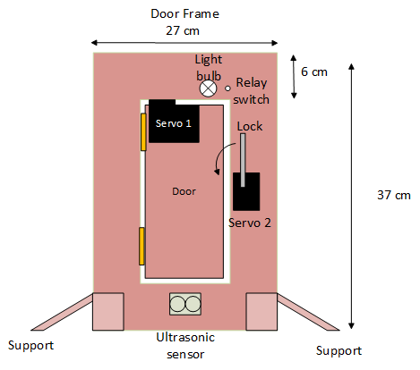
Initial Door Design

Slide 17
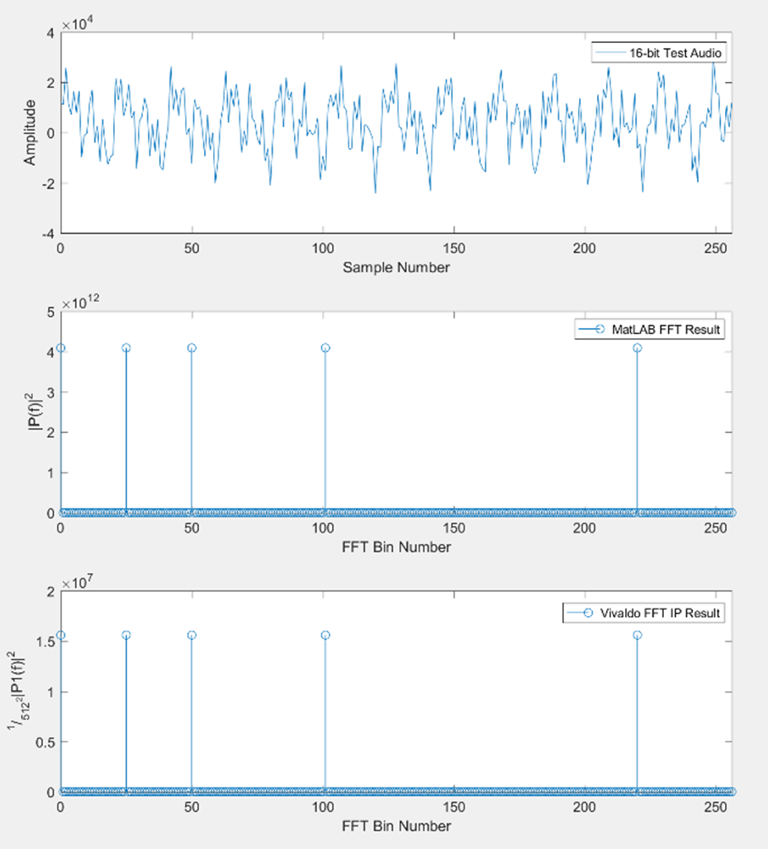
Xilinx FFT Module Configuration 1
16 bits fixed-point output -> not precise enough for our application

Slide 18
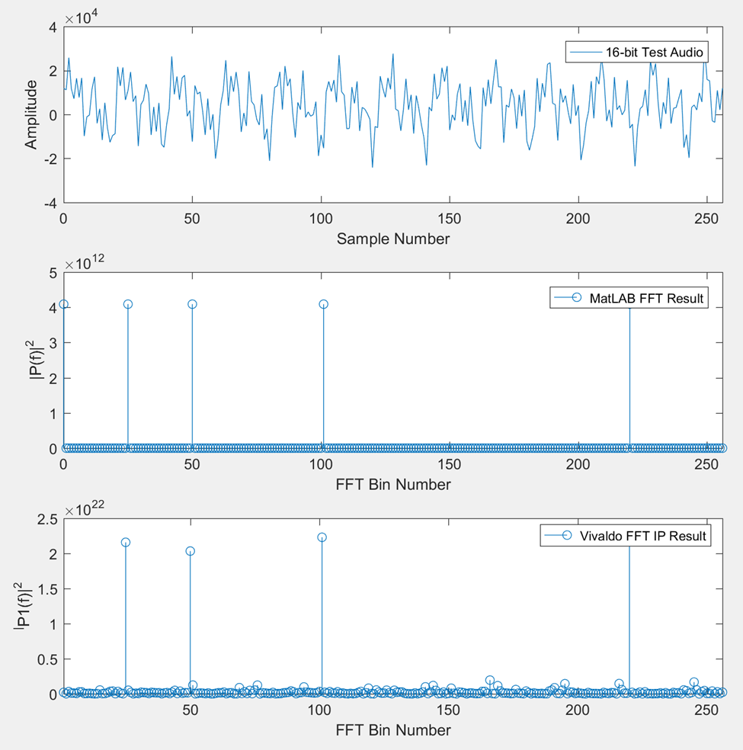
Xilinx FFT Module Configuration 2
Floating point output -> noisy output and uncontrollable output scaling

Slide 19
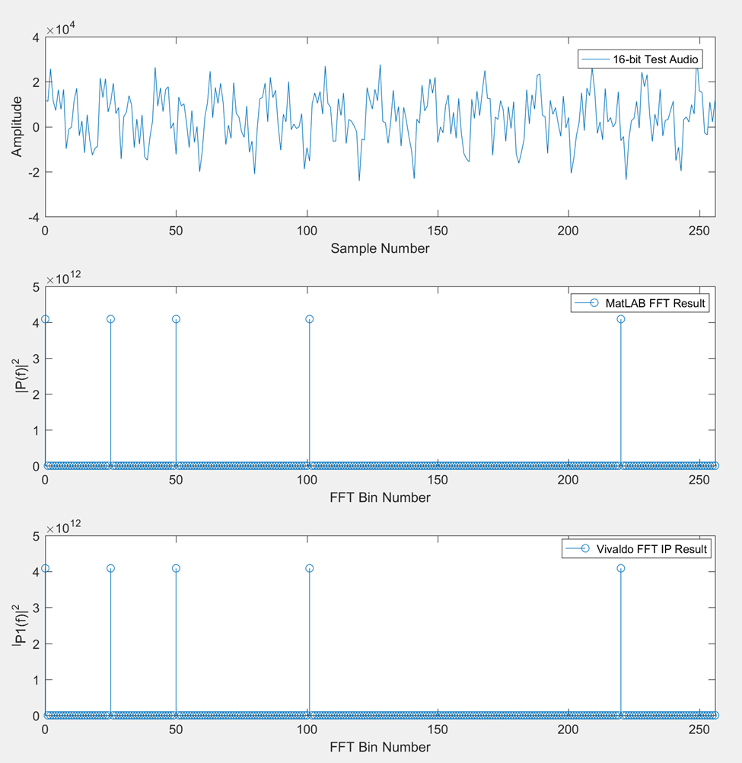
Xilinx FFT Module Configuration 3
32 bits full precision output -> less than 1% error compared with MATLAB FFT

Slide 20
Hardware-acceleration for MFCC
Hardware Configuration | Time for MFCC | Percentage of time
Entirely on software | 8 min. | --
FFT IP implemented | 2 min 34 sec. | 32.08%
FFT & Logarithm IP implemented | 2 min 10 sec. | 27.08%

